Slide 1
Prediction for Forest Cover Type
Abdelrahman Ali
Nada Mahmoud
Alaa Abdullah

Slide 2
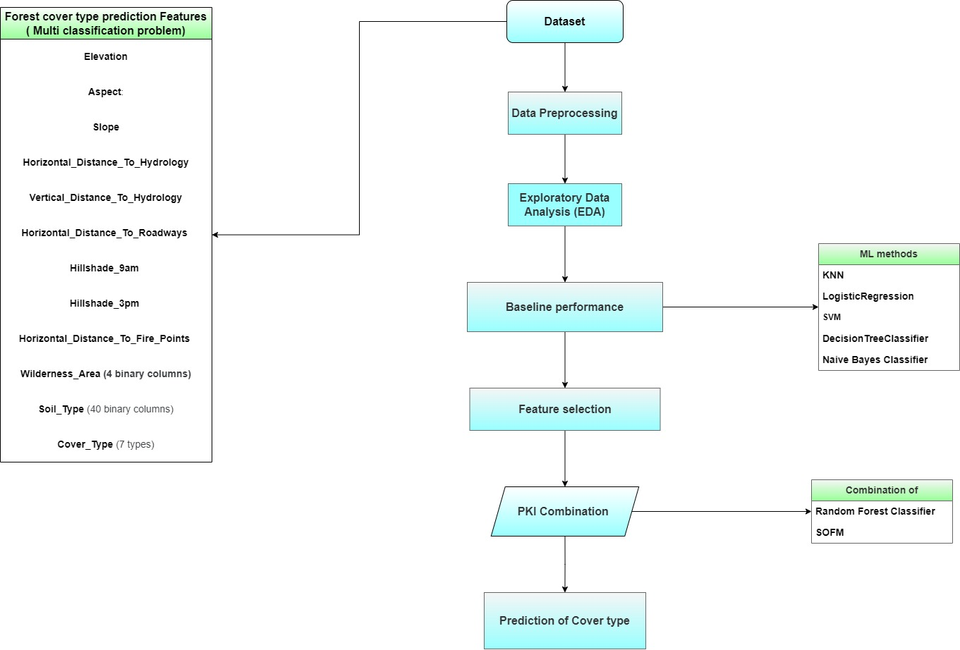
Define the problem

Slide 3
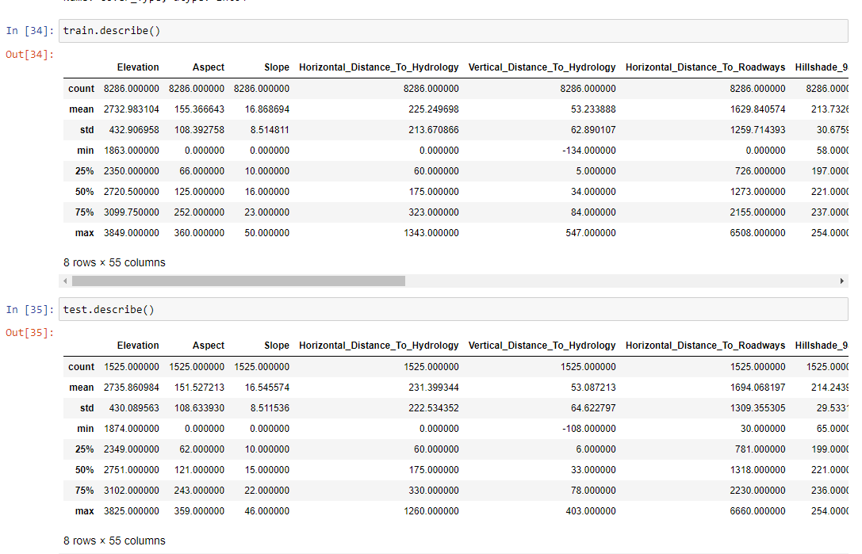
Dataset’s overview (EDA)

Slide 4
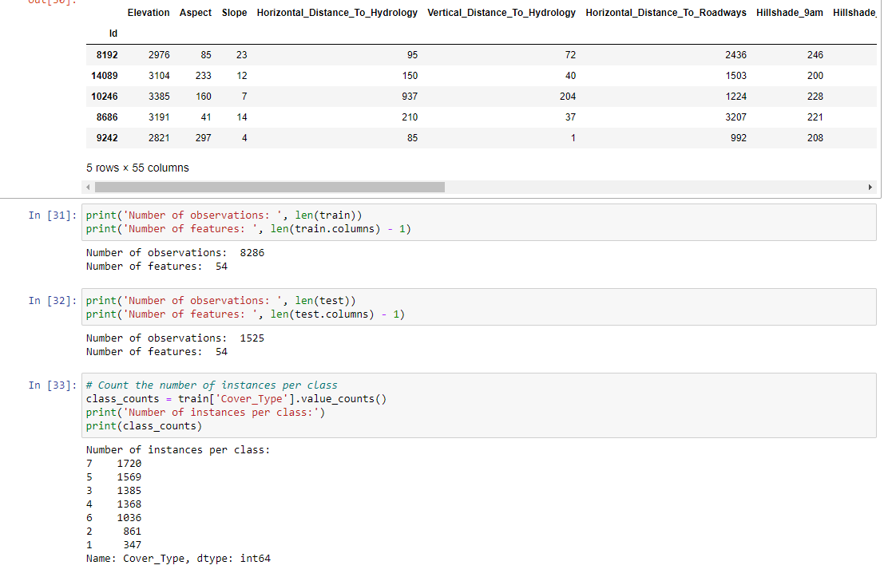
Dataset’s overview (EDA)

Slide 5
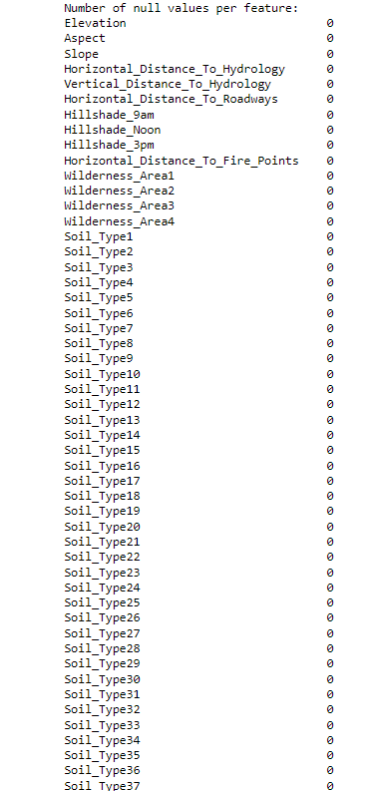
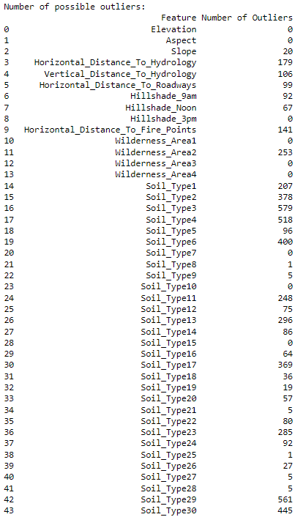
Dataset’s overview (EDA)

Slide 6
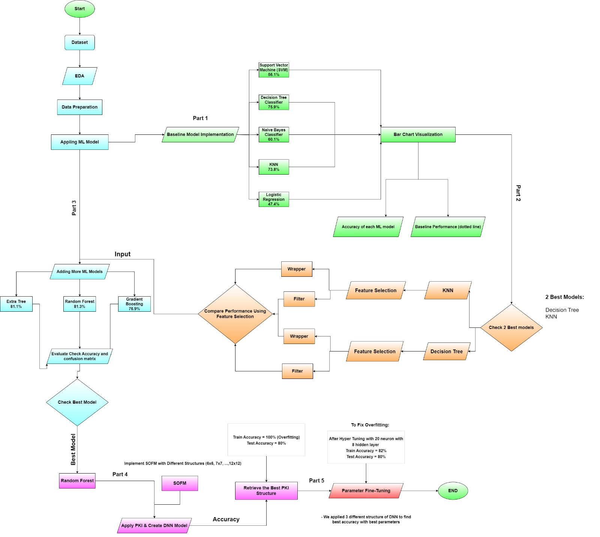
process of the project’s implementation

Slide 7
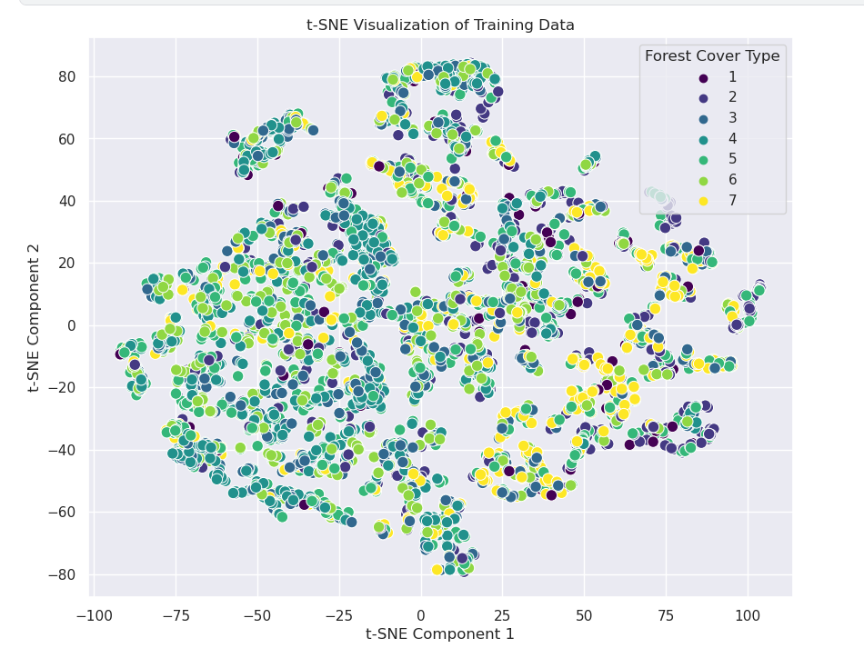
t-SNE Visualization of Training Data

Slide 8
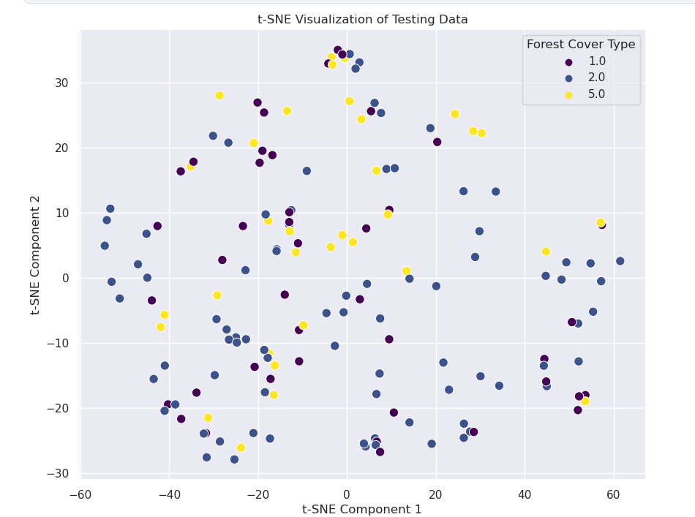
t-SNE Visualization of Testing Data

Slide 9
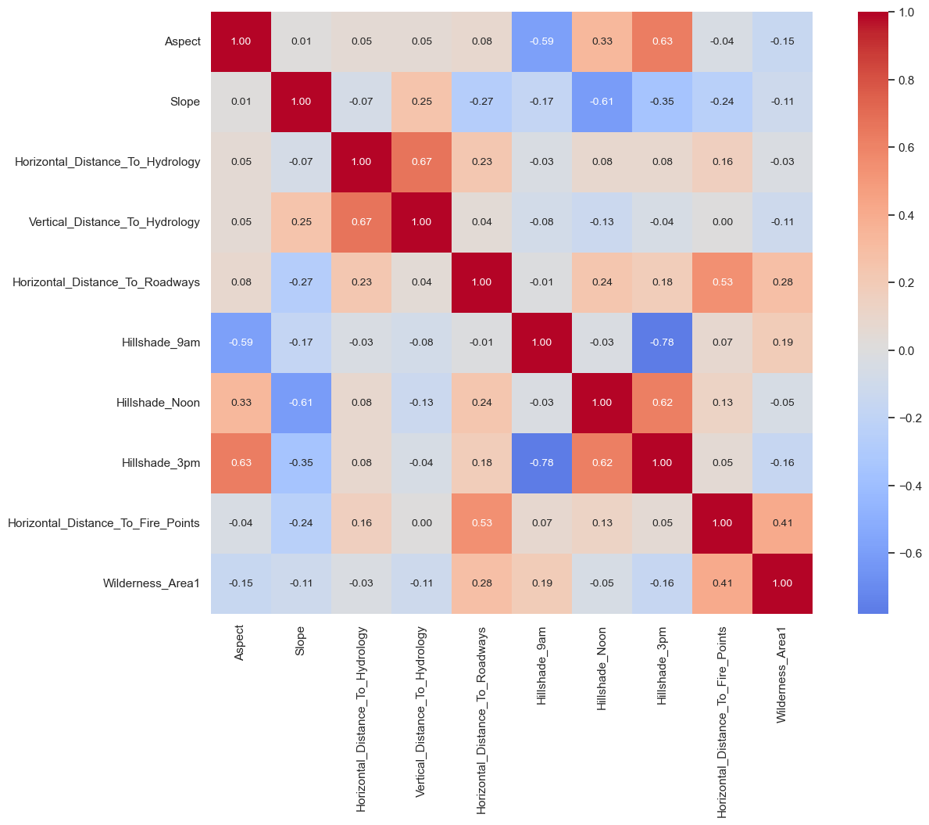
correlation matrix of Features

Slide 10
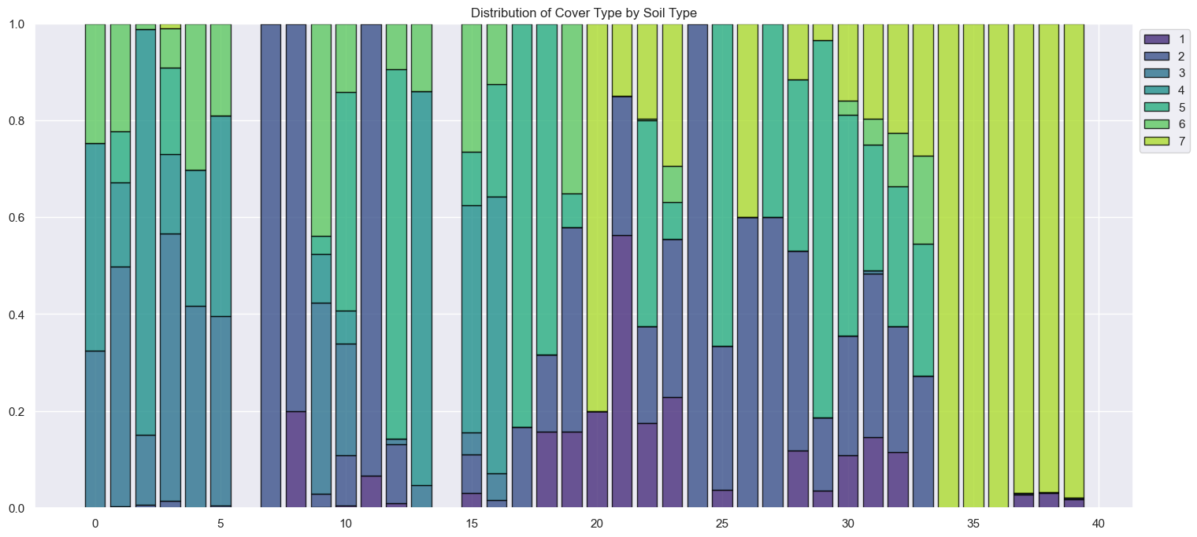
stacked bar chart
stacked bar chart to visualize the distribution of cover types by soil type in the dataset.

Slide 11
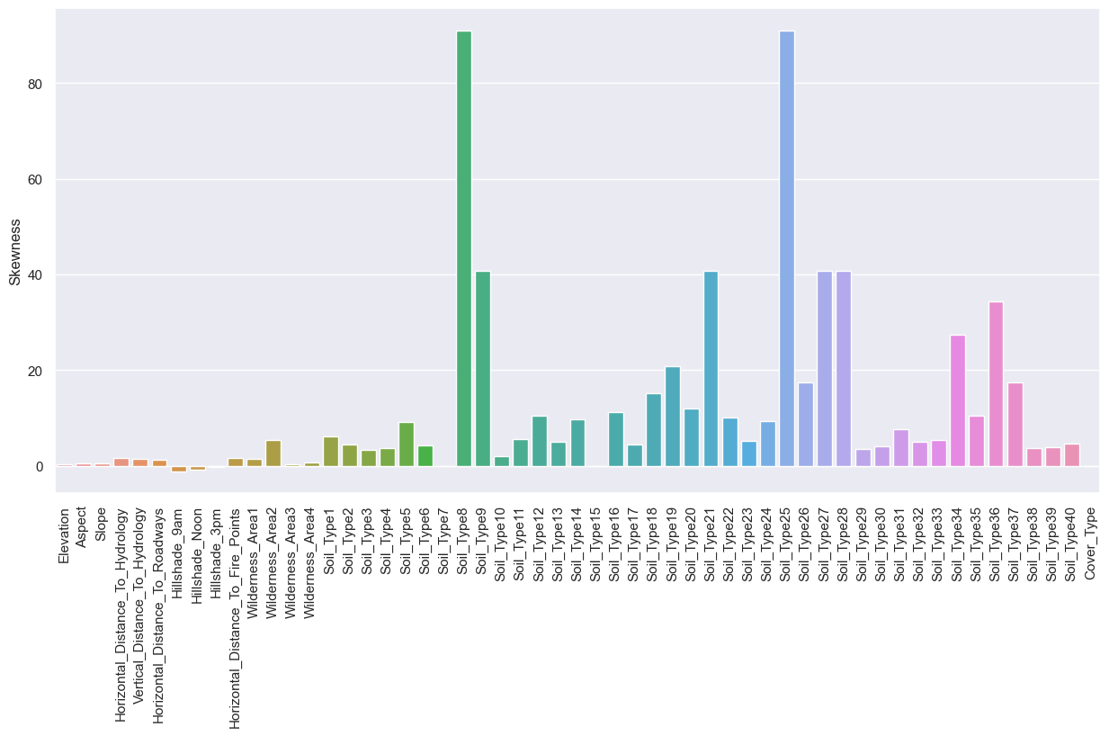
Bar plot
bar plot to visualize the skewness of each feature in the dataset. The resulting plot used to identify any features that require transformation or normalization before being used in a machine learning model.

Slide 12
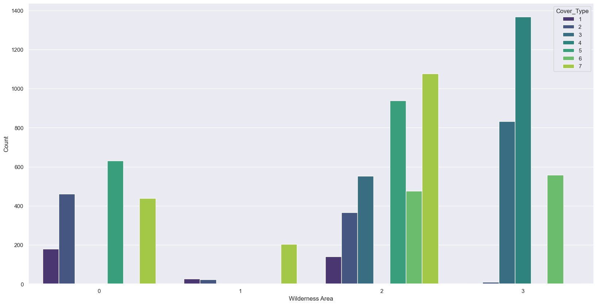
Count plot
count plot to visualize the distribution of cover types for each wilderness area in the dataset. The resulting plot can be used to identify any relationships between the features and the target variable

Slide 13
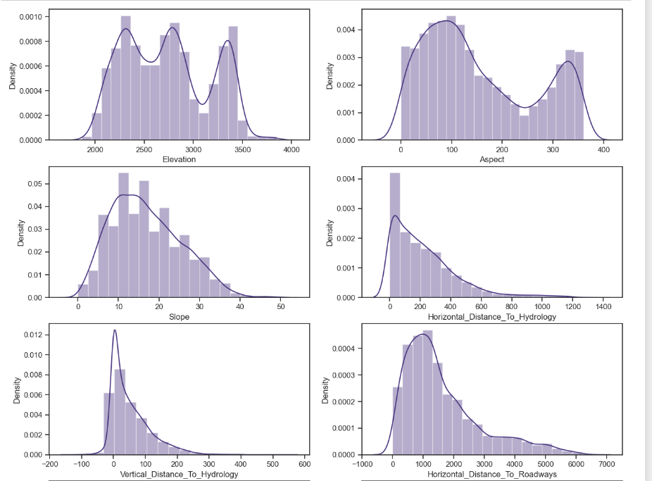
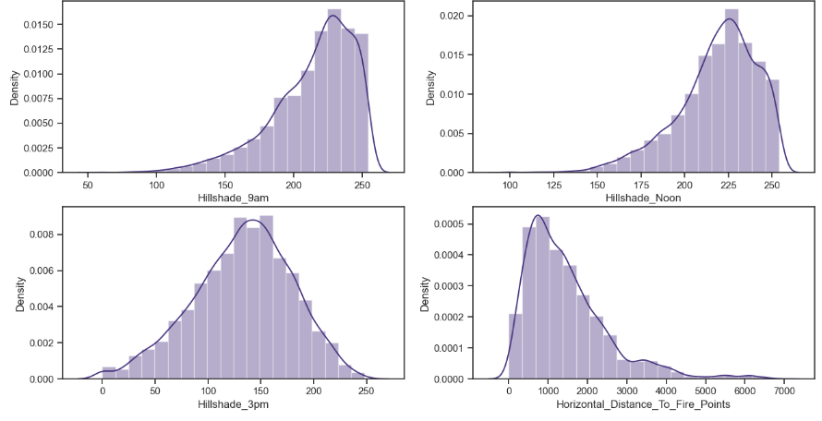
Outliers

Slide 14
Initial 5 classifiers
Decision Tree
01
KNN
02
Naïve Bayes
03
SVM
04
Logistic Regression
05

Slide 15
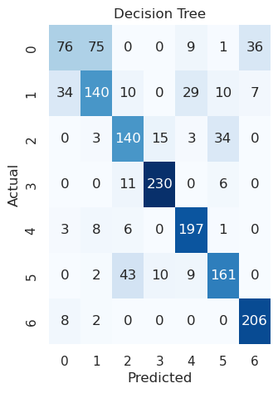
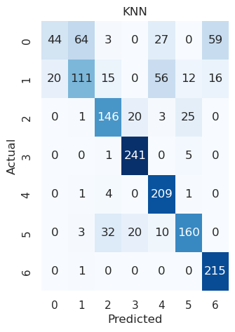
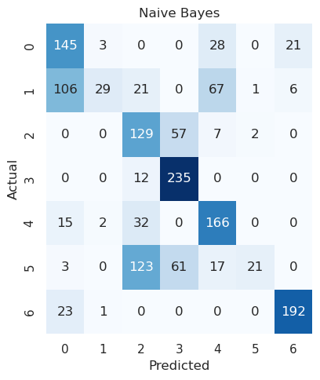
Confusion Matrix

Slide 16
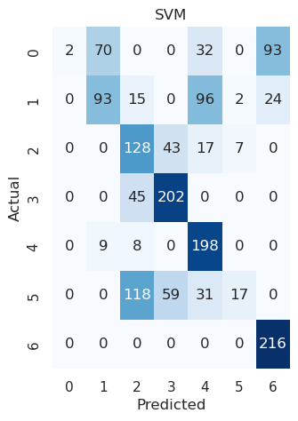
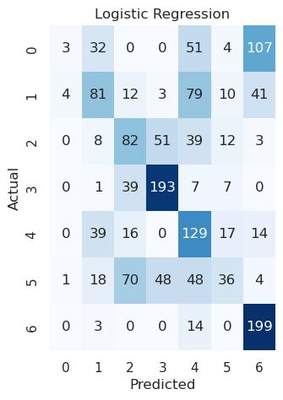
Confusion Matrix

Slide 17
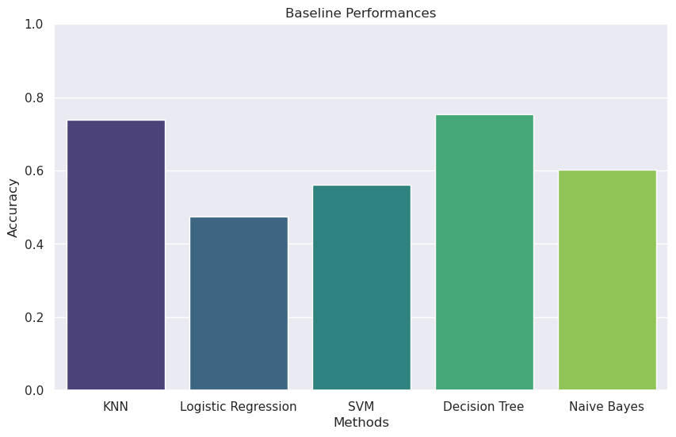
baseline performances

Slide 18
First Improvement
01
Filter -based feature selection
First Improvement strategy
02
wrapper-based feature selection

Slide 19
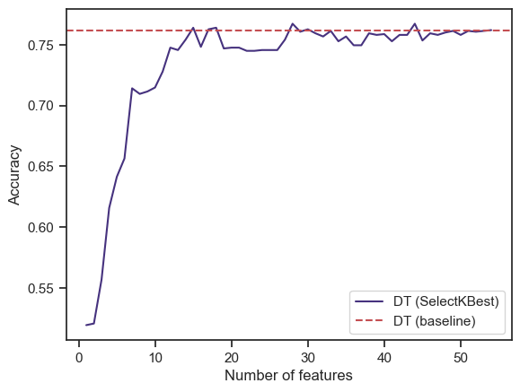
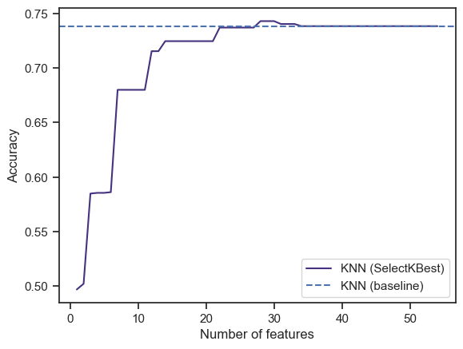
filter-based feature selection using SelectKBest

Slide 20
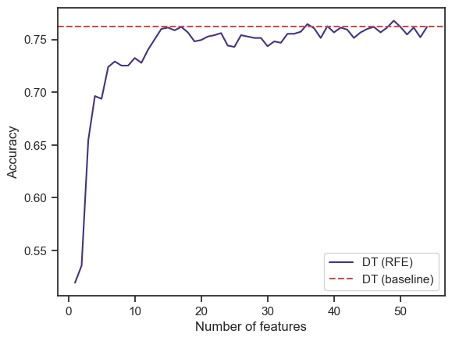
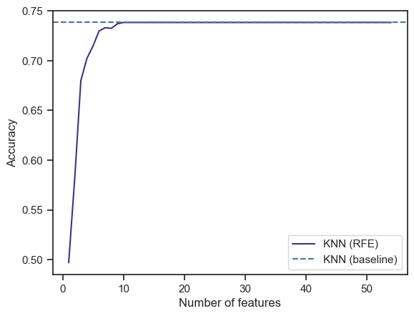
Wrapper-based feature selection using using RFE

Slide 21
Second Improvment
81.24%
81.11%
76%
Random Forest
Extra Trees
Gradient Boosting

Slide 22
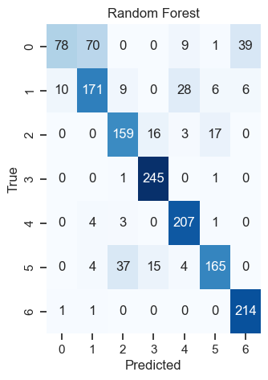
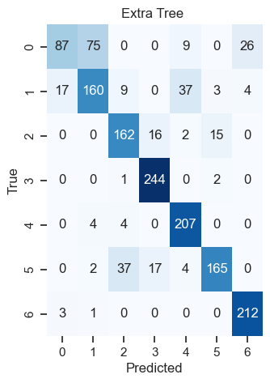
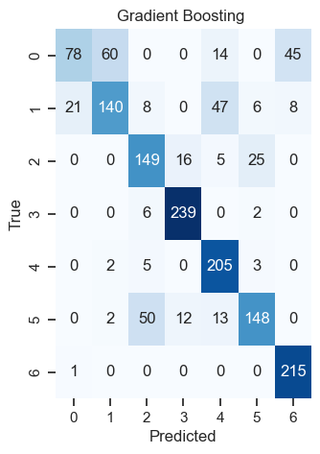
confusion matrix

Slide 23
Our Champion Model
Random Forest with accuracy =81.24%

Slide 24
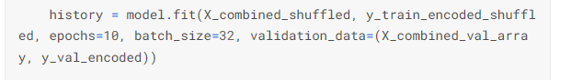


Implement NN
1
combination of random forest prediction and sofm structure
2
For 30 neuron units activation function “tanh”
For learning_rate = 0.001
3
Plot every accuracy_score for each iteration
3

Slide 25
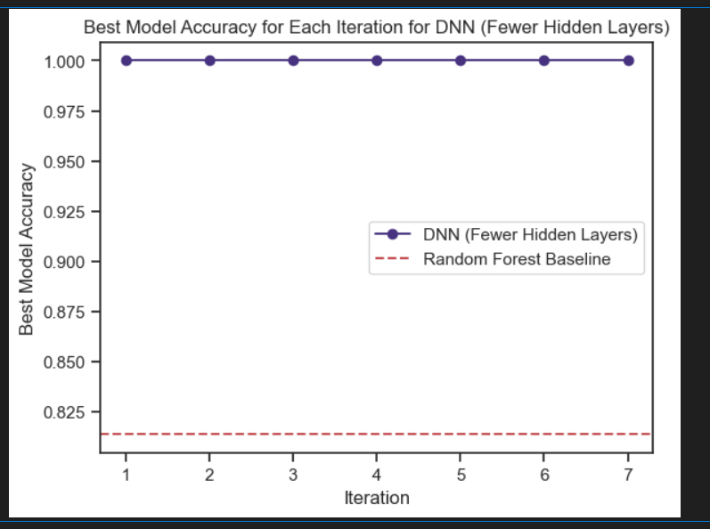
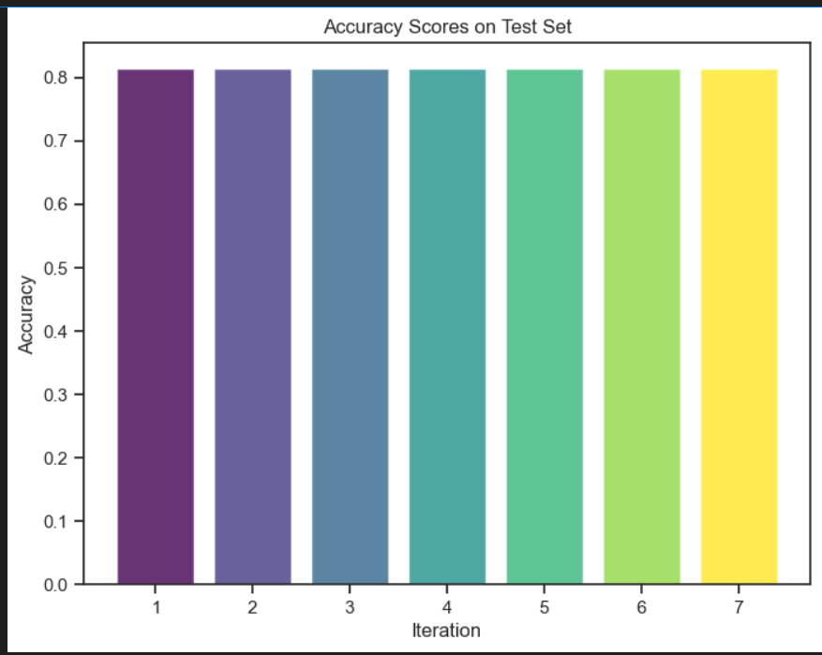
Output of neural network
Overfitting

Slide 26
Apply parameter fine tuning
By try more or less hidden layers
First Model
Accuracy is higher compared to the main model, which indicates better generalization.
Second Model
shows an improvement in accuracy to the main model.
Third Model
performs worse than the previous models

Slide 27
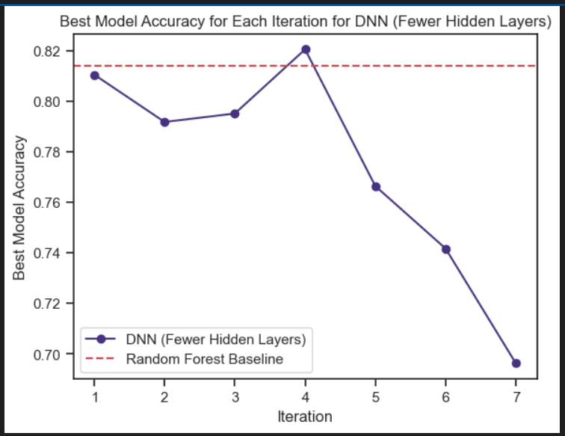
Output of neural network First Model
20 neuron units
activation='tanh’
Hidden layers=11
Indicates better generalization

Slide 28
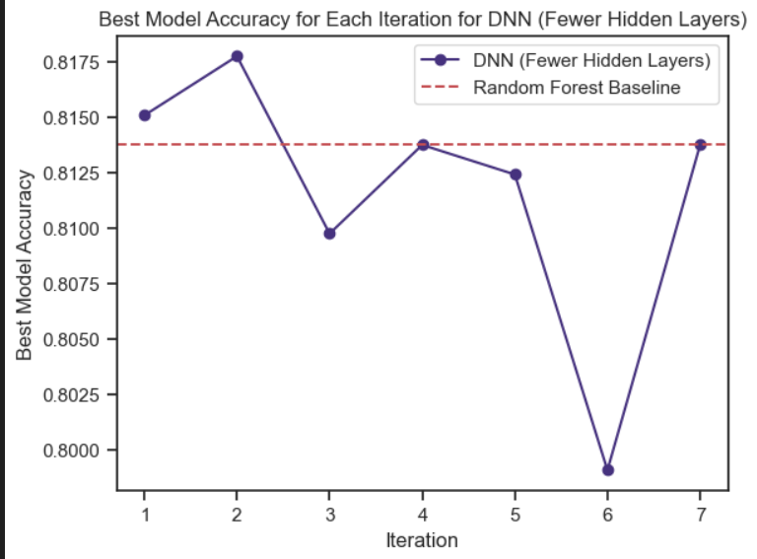
Output of neural network Second Model
40 neuron units
activation='tanh’
Hidden layers=8
The other good one

Slide 29
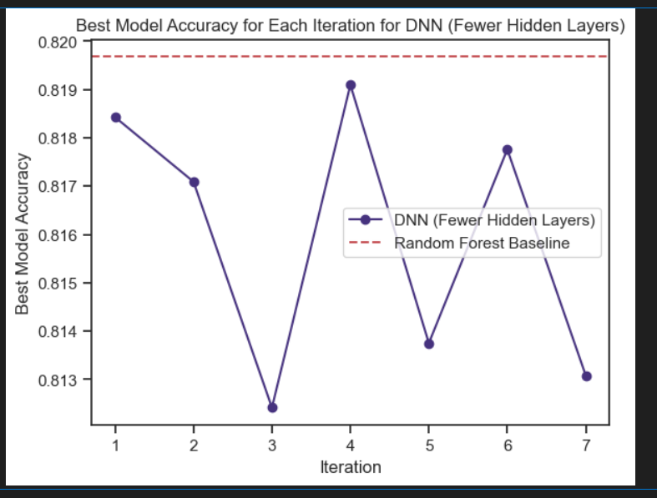




Output of neural network Third Model
64 neuron units
activation='tanh’
Hidden layers=11
The other good one

Slide 30
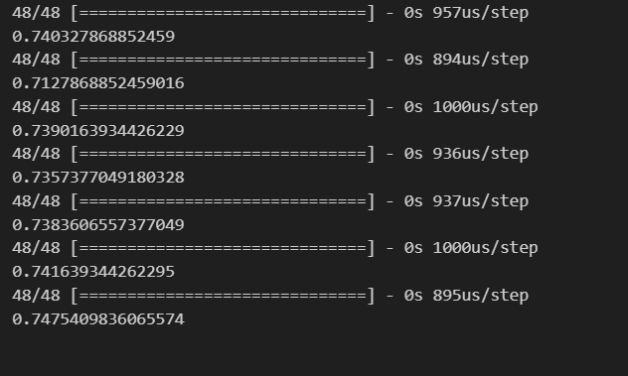









Output of neural network Third Model
Apply it for test dataset

Slide 31
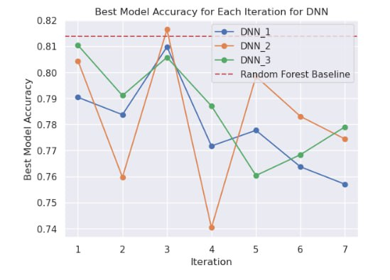
Output of neural network Model

Slide 32
Thank You

